Slide 1
CENSUS REPORTING SYSTEM

Slide 2
Project Team
UNDER THE GUIDANCE OF : MS.PARVATHY SELVAM

Slide 3
Project Objectives
Development of a Census Reporting System.
The purpose of this project is to gather information about general population in order to present a full and reliable picture of population in Cities- its Demographic and housing conditions, social and economic characteristics.

Slide 4
Project Flow
DATA WARE HOUSE
Heterogeneous Sources
i.e
Operation Data
(Excel Sheet, Flat Files)
DATA SET
REPORTS BASED ON DATA SET
EXTRACT
TRANSFORM
LOAD

Slide 5
STAR SCHEMA
FACT_CENSUS_OCC
Person_id | Varchar
Door_num | Number(p,s)
Gender | Varchar
DOB | Varchar
Maritial_status | Varchar
Religion | Varchar
Caste | Varchar
Disability | Varchar
Type_of_disability | Varchar
status_of_attendance | Varchar
Occupation_id | Varchar
Occupation | Varchar
Nature_of_industry | Varchar
sector | Varchar
Salary | Number(p,s)
Children_surviving | Varchar
Children_ever_born | Varchar
Persons_expired_in_10yr | Varchar
Type_of_house | Varchar
PAN_card | Varchar
Ration_card | Varchar
Adhar_card | Varchar
Area | Varchar
City_id | Varchar
Literacy_status | Varchar
Mode_of_transport | Varchar
City_name | Varchar
FACT_CENSUS_EDU
Person_id | Varchar
Door_num | Number(p,s)
Gender | Varchar
DOB | Date/time
Maritial_status | Varchar
Religion | Varchar
Caste | Varchar
Disability | Varchar
Type_of_disability | Varchar
status_of_attendance | Varchar
Education_id | Varchar
Highest_Education | Varchar
Nature_of_industry | Varchar
sector | Varchar
Salary | Number(p,s)
Children_surviving | Varchar
Children_ever_born | Varchar
Persons_expired_in_10yr | Varchar
Type_of_house | Varchar
PAN_card | Varchar
Ration_card | Varchar
Adhar_card | Varchar
Area | Varchar
City_id | Varchar
Literacy_status | Varchar
Mode_of_transport | Varchar
City_name | Varchar
DIM_EDUCATION
Education_id | Varchar
Highest_education | Varchar
DIM_OCCUPATION
Occupation_id | Varchar
Occupation_name | Varchar
DIM_CITY
City_id | Varchar
City_name | Varchar

Slide 6
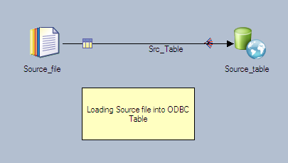
DESIGN PROCESS

Slide 7
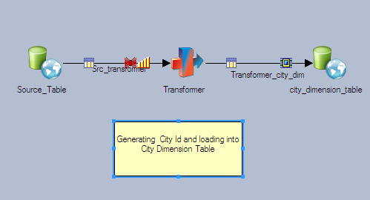

Slide 8
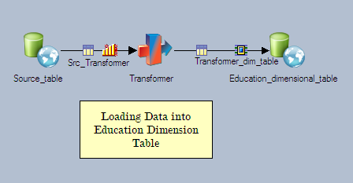

Slide 9
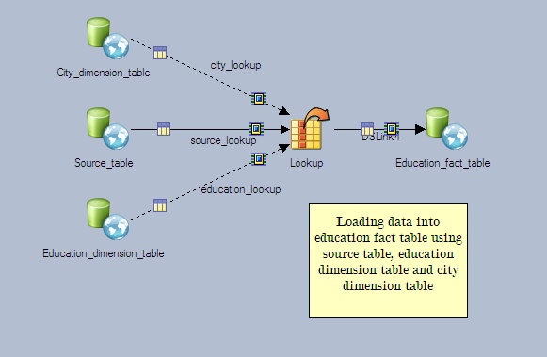

Slide 10
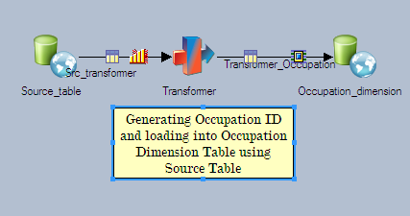

Slide 11
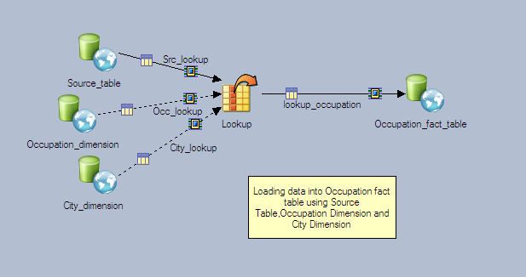

Slide 12
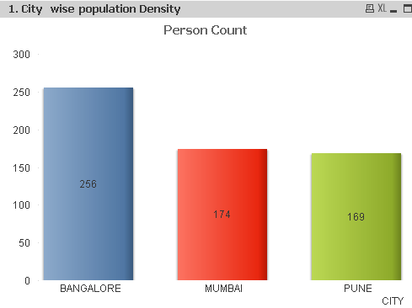

Slide 13
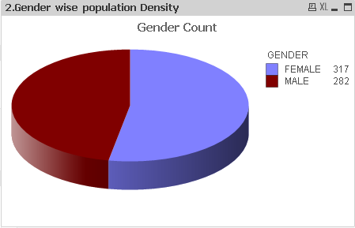

Slide 14
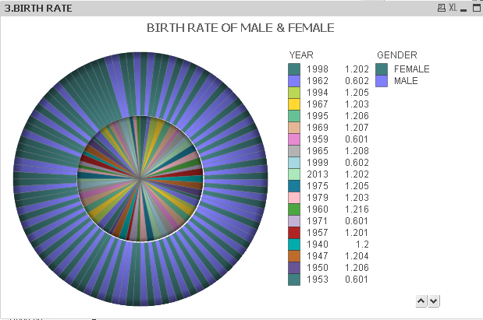

Slide 15
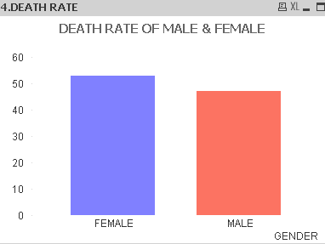

Slide 16
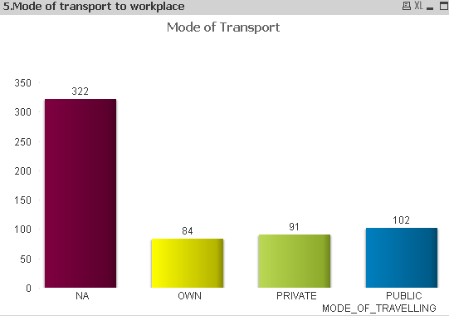

Slide 17
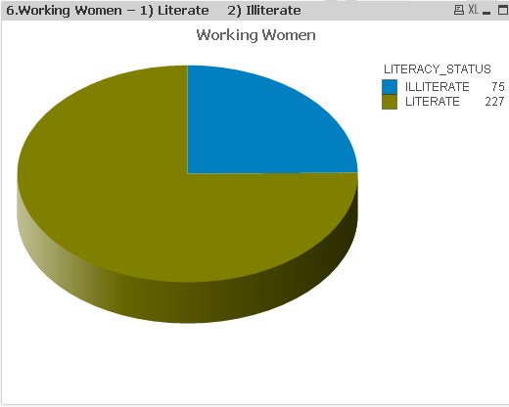

Slide 18
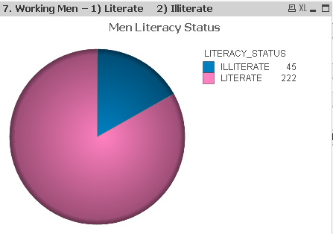

Slide 19
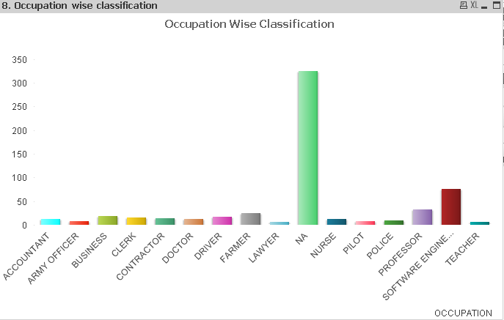

Slide 20
